Slide 1
Eyeriss-like CNN Accelerator
AIHA Intern 2023 NPU
Minjae Lee
Hanyang University
lmj4666@hanyang.ac.kr
2023.08.18

Slide 2
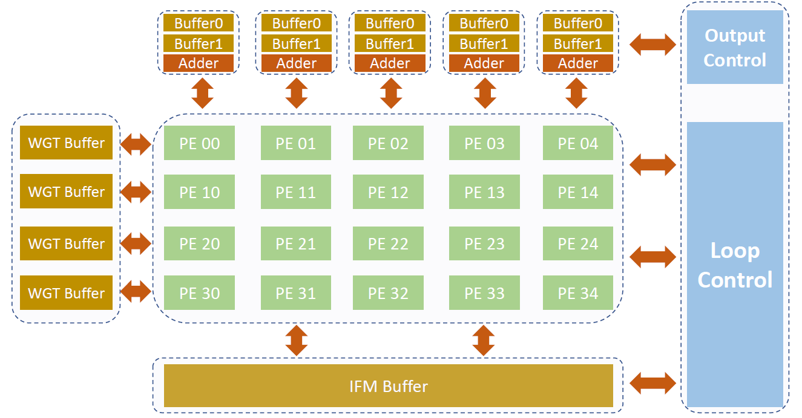
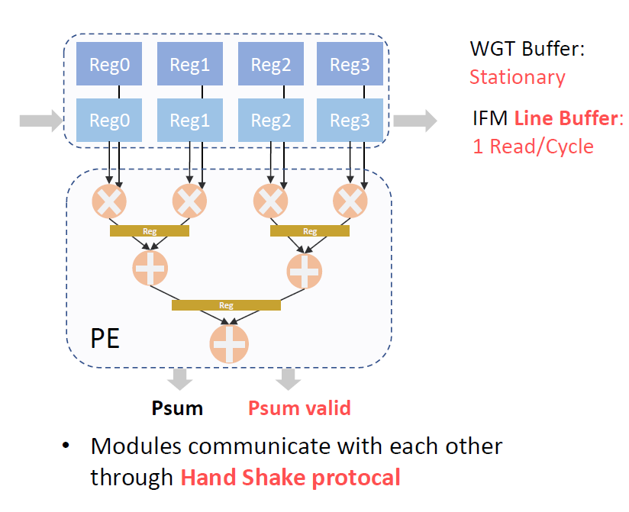
Eyeriss-like CNN Accelerator
Architecture: 2D PE Array
  Weight-stationary (Row-stationary: Eyeriss)
  Column-wise adder tree

Slide 3
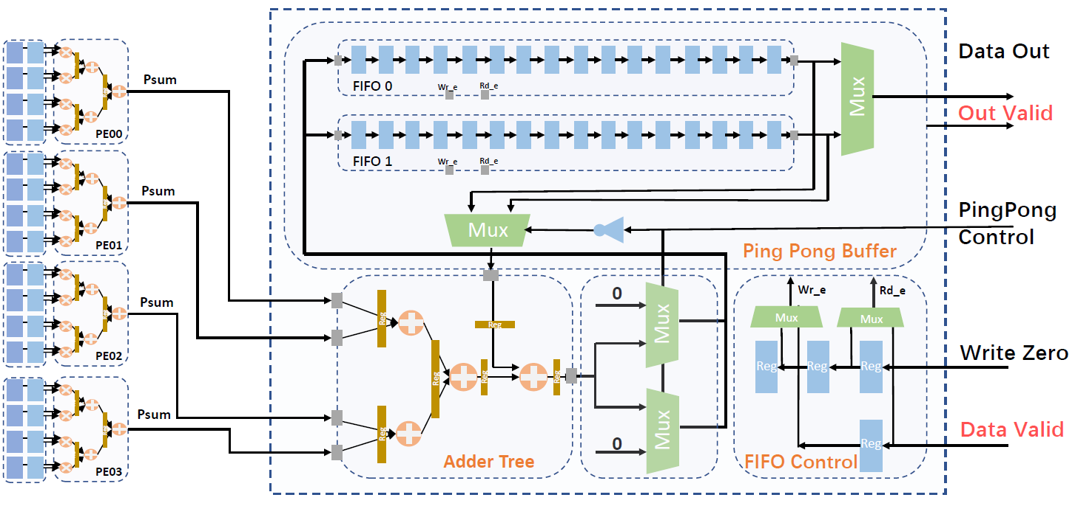


Eyeriss-like CNN Accelerator
How to compute CNN?
  Mapping
    Each column of array → 1 output feature
    # of PE rows → an integer multiple of K_{H} (K_{H}: kernel height)
    # of multiplier per PE → K_{W} (K_{W}: kernel width)
Input
Weight
Output
Output Feature Tile
0 | 1 | 2 | 3 | 4 | 5 | 6 | 7 | 8 | 9 | 10 | 11 | 12 | 13 | 14 | 15 | 16 | 17 | 18
19 | 20 | 21 | 22 | 23 | 24 | 25 | 26 | 27 | 28 | 29 | 30 | 31 | 32 | 33 | 34 | 35 | 36 | 37
38 | 39 | 40 | 41 | 42 | 43 | 44 | 45 | 46 | 47 | 48 | 49 | 50 | 51 | 52 | 53 | 54 | 55 | 56
57 | 58 | 59 | 60 | 61 | 62 | 63 | 64 | 65 | 66 | 67 | 68 | 69 | 70 | 71 | 72 | 73 | 74 | 75
76 | 77 | 78 | 79 | 80 | 81 | 82 | 83 | 84 | 85 | 86 | 87 | 88 | 89 | 90 | 91 | 92 | 93 | 94
95 | 96 | 97 | 98 | 99 | 100 | 101 | 102 | 103 | 104 | 105 | 106 | 107 | 108 | 109 | 110 | 111 | 112 | 113
114 | 115 | 116 | 117 | 118 | 119 | 120 | 121 | 122 | 123 | 124 | 125 | 126 | 127 | 128 | 129 | 130 | 131 | 132
133 | 134 | 135 | 136 | 137 | 138 | 139 | 140 | 141 | 142 | 143 | 144 | 145 | 146 | 147 | 148 | 149 | 150 | 151
$$×$$
0 | 1 | 2 | 3
4 | 5 | 6 | 7
8 | 9 | 10 | 11
12 | 13 | 14 | 15
$$=$$
0 | 1 | 2 | 3 | 4 | 5 | 6 | 7 | 8 | 9 | 10 | 11 | 12 | 13 | 14 | 15
16 | 17 | 18 | 19 | 20 | 21 | 22 | 23 | 24 | 25 | 26 | 27 | 28 | 29 | 30 | 31
32 | 33 | 34 | 35 | 36 | 37 | 38 | 39 | 40 | 41 | 42 | 43 | 44 | 45 | 46 | 47
48 | 49 | 50 | 51 | 52 | 53 | 54 | 55 | 56 | 57 | 58 | 59 | 60 | 61 | 62 | 63
64 | 65 | 66 | 67 | 68 | 69 | 70 | 71 | 72 | 73 | 74 | 75 | 76 | 77 | 78 | 79
0 | 1 | 2 | 3
PE
PE
PE
PE
PE
0 | 1 | 2 | 3
PE
PE
PE
PE
PE
Kernel Size
0 | 1 | 2 | 3
PE
PE
PE
PE
PE
0 | 1 | 2 | 3
PE
PE
PE
PE
PE
0
13
26
39
52
Weight (Row) Stationary

Slide 4


Eyeriss-like CNN Accelerator
How to compute CNN?
  Permutation
    Tile → Input channel → Output channel
    Entire tile size = tile length $×$ sub tile size (sub tile size = # Column of PE Array)
      CNN Accelerator: 4 $×$ 5 PE array (4 Multiplier per PE) 이고, tile length를 16으로 설정하면, 하나의 tile 크기는 16 $×$ 5 output feature 크기에 해당함 (TO: output tile, TI: input tile, *_{H}: height, *_{W}: width)
        Output: 16 $×$ 5 (TO_{H} $×$ TO_{W}) → Partial Sum buffer: 16 $×$ 5 $×$ 32-bit $×$ 2 (ping pong buffer) = 0.625 KB
        Weight: 4 $×$ 4 $×$ 8 (K_{H} $×$K_{W} $×$C_{in}) → Weight buffer: 4 $×$ 4 $×$ 8 $×$ 8-bit = 0.125 KB
        Input: 19 $×$ 8 $×$ 8 (TI_{H} $×$ TI_{W} $×$ C_{in}) → Input buffer: 19 $×$ 8 $×$ 8 $×$ 8-bit = 1.187 KB
② input channel
SubTile
: PE array 상에서 한번에 병렬적으로 처리 가능한 크기
(spatial parallel)
① tile length
SubTile
Entire Tile
: 연산 순서 ①~④ (temporal)
$×$ output channel times ④
③ output feature
Notes:
Kernel width: 4 / kernel height: 5 / sub tile size: 5

Slide 5
Eyeriss-like CNN Accelerator – Timestamp
0 | 1 | 2 | 3 | 4 | 5 | 6 | 7 | 8 | 9 | 10 | 11 | 12 | 13 | 14 | 15 | 16 | 17 | 18
19 | 20 | 21 | 22 | 23 | 24 | 25 | 26 | 27 | 28 | 29 | 30 | 31 | 32 | 33 | 34 | 35 | 36 | 37
38 | 39 | 40 | 41 | 42 | 43 | 44 | 45 | 46 | 47 | 48 | 49 | 50 | 51 | 52 | 53 | 54 | 55 | 56
57 | 58 | 59 | 60 | 61 | 62 | 63 | 64 | 65 | 66 | 67 | 68 | 69 | 70 | 71 | 72 | 73 | 74 | 75
76 | 77 | 78 | 79 | 80 | 81 | 82 | 83 | 84 | 85 | 86 | 87 | 88 | 89 | 90 | 91 | 92 | 93 | 94
95 | 96 | 97 | 98 | 99 | 100 | 101 | 102 | 103 | 104 | 105 | 106 | 107 | 108 | 109 | 110 | 111 | 112 | 113
114 | 115 | 116 | 117 | 118 | 119 | 120 | 121 | 122 | 123 | 124 | 125 | 126 | 127 | 128 | 129 | 130 | 131 | 132
133 | 134 | 135 | 136 | 137 | 138 | 139 | 140 | 141 | 142 | 143 | 144 | 145 | 146 | 147 | 148 | 149 | 150 | 151
Cycle 0
PE00
PE01
PE02
PE03
PE04
PE10
PE11
PE12
PE13
PE14
PE20
PE21
PE22
PE23
PE24
0 | 1 | 2 | 3
4 | 5 | 6 | 7
8 | 9 | 10 | 11
12 | 13 | 14 | 15
PE30
PE31
PE32
PE33
PE34
0 | 1 | 2 | 3 | 4 | 5 | 6 | 7 | 8 | 9 | 10 | 11 | 12 | 13 | 14 | 15
16 | 17 | 18 | 19 | 20 | 21 | 22 | 23 | 24 | 25 | 26 | 27 | 28 | 29 | 30 | 31
32 | 33 | 34 | 35 | 36 | 37 | 38 | 39 | 40 | 41 | 42 | 43 | 44 | 45 | 46 | 47
48 | 49 | 50 | 51 | 52 | 53 | 54 | 55 | 56 | 57 | 58 | 59 | 60 | 61 | 62 | 63
64 | 65 | 66 | 67 | 68 | 69 | 70 | 71 | 72 | 73 | 74 | 75 | 76 | 77 | 78 | 79

Slide 6
Eyeriss-like CNN Accelerator – Timestamp
0 | 1 | 2 | 3 | 4 | 5 | 6 | 7 | 8 | 9 | 10 | 11 | 12 | 13 | 14 | 15 | 16 | 17 | 18
19 | 20 | 21 | 22 | 23 | 24 | 25 | 26 | 27 | 28 | 29 | 30 | 31 | 32 | 33 | 34 | 35 | 36 | 37
38 | 39 | 40 | 41 | 42 | 43 | 44 | 45 | 46 | 47 | 48 | 49 | 50 | 51 | 52 | 53 | 54 | 55 | 56
57 | 58 | 59 | 60 | 61 | 62 | 63 | 64 | 65 | 66 | 67 | 68 | 69 | 70 | 71 | 72 | 73 | 74 | 75
76 | 77 | 78 | 79 | 80 | 81 | 82 | 83 | 84 | 85 | 86 | 87 | 88 | 89 | 90 | 91 | 92 | 93 | 94
95 | 96 | 97 | 98 | 99 | 100 | 101 | 102 | 103 | 104 | 105 | 106 | 107 | 108 | 109 | 110 | 111 | 112 | 113
114 | 115 | 116 | 117 | 118 | 119 | 120 | 121 | 122 | 123 | 124 | 125 | 126 | 127 | 128 | 129 | 130 | 131 | 132
133 | 134 | 135 | 136 | 137 | 138 | 139 | 140 | 141 | 142 | 143 | 144 | 145 | 146 | 147 | 148 | 149 | 150 | 151
Cycle 1 (input channel: 0)
PE00
PE01
PE02
PE03
PE04
 |  |  | 0
 |  |  | 19
 |  |  | 38
 |  |  | 57
 |  |  | 76
 |  |  | 0
 |  |  | 0
 |  |  | 0
 |  |  | 0
 |  |  | 0
PE10
PE11
PE12
PE13
PE14
 |  |  | 19
 |  |  | 38
 |  |  | 57
 |  |  | 76
 |  |  | 95
 |  |  | 4
 |  |  | 4
 |  |  | 4
 |  |  | 4
 |  |  | 4
PE20
PE21
PE22
PE23
PE24
0 | 1 | 2 | 3
4 | 5 | 6 | 7
8 | 9 | 10 | 11
12 | 13 | 14 | 15
 |  |  | 38
 |  |  | 57
 |  |  | 76
 |  |  | 95
 |  |  | 114
 |  |  | 8
 |  |  | 8
 |  |  | 8
 |  |  | 8
 |  |  | 8
PE30
PE31
PE32
PE33
PE34
0 | 1 | 2 | 3 | 4 | 5 | 6 | 7 | 8 | 9 | 10 | 11 | 12 | 13 | 14 | 15
16 | 17 | 18 | 19 | 20 | 21 | 22 | 23 | 24 | 25 | 26 | 27 | 28 | 29 | 30 | 31
32 | 33 | 34 | 35 | 36 | 37 | 38 | 39 | 40 | 41 | 42 | 43 | 44 | 45 | 46 | 47
48 | 49 | 50 | 51 | 52 | 53 | 54 | 55 | 56 | 57 | 58 | 59 | 60 | 61 | 62 | 63
64 | 65 | 66 | 67 | 68 | 69 | 70 | 71 | 72 | 73 | 74 | 75 | 76 | 77 | 78 | 79
 |  |  | 57
 |  |  | 76
 |  |  | 95
 |  |  | 114
 |  |  | 133
 |  |  | 12
 |  |  | 12
 |  |  | 12
 |  |  | 12
 |  |  | 12
Notes:
현재 사진에 나와있는 PE의 가로에 Weight Stationary하게 값이 들어감
알아야 하는 것은 세로가 이제 row로 매겨지는 것. 1째 줄: 0이 stationary, 2째줄: 4가 stationary, 3째줄: 8이 stationary, 4째줄: 12가 stationary
(즉, PE00/01/02/03/04에 0, PE10/11/12/13/14에 4, PE20/21/22/23/24에 8, PE30/31/32/33/34에 12)
이후, Diagonal하게 (대각선에 중복이 되도록) input feature map data가 들어감.
Diagonal이 8개 이므로 한 번에 8개의 data가 사용되는 것을 알 수 있음 (들어가는 값은 IFM).
(즉, P00에 0, P01/10에 19, P02/11/20에 38, P03/12/21/30에 57, P04/13/22/31에 76, P14/23/32에 95, P24/33에 114, P34에 133이 들어가는 것을 확인할 수 있다 – Row Stationary)

Slide 7
Eyeriss-like CNN Accelerator – Timestamp
0 | 1 | 2 | 3 | 4 | 5 | 6 | 7 | 8 | 9 | 10 | 11 | 12 | 13 | 14 | 15 | 16 | 17 | 18
19 | 20 | 21 | 22 | 23 | 24 | 25 | 26 | 27 | 28 | 29 | 30 | 31 | 32 | 33 | 34 | 35 | 36 | 37
38 | 39 | 40 | 41 | 42 | 43 | 44 | 45 | 46 | 47 | 48 | 49 | 50 | 51 | 52 | 53 | 54 | 55 | 56
57 | 58 | 59 | 60 | 61 | 62 | 63 | 64 | 65 | 66 | 67 | 68 | 69 | 70 | 71 | 72 | 73 | 74 | 75
76 | 77 | 78 | 79 | 80 | 81 | 82 | 83 | 84 | 85 | 86 | 87 | 88 | 89 | 90 | 91 | 92 | 93 | 94
95 | 96 | 97 | 98 | 99 | 100 | 101 | 102 | 103 | 104 | 105 | 106 | 107 | 108 | 109 | 110 | 111 | 112 | 113
114 | 115 | 116 | 117 | 118 | 119 | 120 | 121 | 122 | 123 | 124 | 125 | 126 | 127 | 128 | 129 | 130 | 131 | 132
133 | 134 | 135 | 136 | 137 | 138 | 139 | 140 | 141 | 142 | 143 | 144 | 145 | 146 | 147 | 148 | 149 | 150 | 151
Cycle 2 (input channel: 0)
PE00
PE01
PE02
PE03
PE04
 |  | 0 | 1
 |  | 19 | 20
 |  | 38 | 39
 |  | 57 | 58
 |  | 76 | 77
 |  | 0 | 1
 |  | 0 | 1
 |  | 0 | 1
 |  | 0 | 1
 |  | 0 | 1
PE10
PE11
PE12
PE13
PE14
 |  | 19 | 20
 |  | 38 | 39
 |  | 57 | 58
 |  | 76 | 77
 |  | 95 | 96
 |  | 4 | 5
 |  | 4 | 5
 |  | 4 | 5
 |  | 4 | 5
 |  | 4 | 5
PE20
PE21
PE22
PE23
PE24
0 | 1 | 2 | 3
4 | 5 | 6 | 7
8 | 9 | 10 | 11
12 | 13 | 14 | 15
 |  | 38 | 39
 |  | 57 | 58
 |  | 76 | 77
 |  | 95 | 96
 |  | 114 | 115
 |  | 8 | 9
 |  | 8 | 9
 |  | 8 | 9
 |  | 8 | 9
 |  | 8 | 9
PE30
PE31
PE32
PE33
PE34
0 | 1 | 2 | 3 | 4 | 5 | 6 | 7 | 8 | 9 | 10 | 11 | 12 | 13 | 14 | 15
16 | 17 | 18 | 19 | 20 | 21 | 22 | 23 | 24 | 25 | 26 | 27 | 28 | 29 | 30 | 31
32 | 33 | 34 | 35 | 36 | 37 | 38 | 39 | 40 | 41 | 42 | 43 | 44 | 45 | 46 | 47
48 | 49 | 50 | 51 | 52 | 53 | 54 | 55 | 56 | 57 | 58 | 59 | 60 | 61 | 62 | 63
64 | 65 | 66 | 67 | 68 | 69 | 70 | 71 | 72 | 73 | 74 | 75 | 76 | 77 | 78 | 79
 |  | 57 | 58
 |  | 76 | 77
 |  | 95 | 96
 |  | 114 | 115
 |  | 133 | 134
 |  | 12 | 13
 |  | 12 | 13
 |  | 12 | 13
 |  | 12 | 13
 |  | 12 | 13
Notes:
Cycle 마다 값이 shift 되면서 들어간다고 이해할 수 있는데, 이전 슬라이드와 마찬가지로 Diagonal하게 reuse되면서 들어간다. 이 경우 input channel은 0이지만, Cycle 수에 따라 data가 어떻게 전달되는지 확인해 볼 수 있다.

Slide 8
Eyeriss-like CNN Accelerator – Timestamp
0 | 1 | 2 | 3 | 4 | 5 | 6 | 7 | 8 | 9 | 10 | 11 | 12 | 13 | 14 | 15 | 16 | 17 | 18
19 | 20 | 21 | 22 | 23 | 24 | 25 | 26 | 27 | 28 | 29 | 30 | 31 | 32 | 33 | 34 | 35 | 36 | 37
38 | 39 | 40 | 41 | 42 | 43 | 44 | 45 | 46 | 47 | 48 | 49 | 50 | 51 | 52 | 53 | 54 | 55 | 56
57 | 58 | 59 | 60 | 61 | 62 | 63 | 64 | 65 | 66 | 67 | 68 | 69 | 70 | 71 | 72 | 73 | 74 | 75
76 | 77 | 78 | 79 | 80 | 81 | 82 | 83 | 84 | 85 | 86 | 87 | 88 | 89 | 90 | 91 | 92 | 93 | 94
95 | 96 | 97 | 98 | 99 | 100 | 101 | 102 | 103 | 104 | 105 | 106 | 107 | 108 | 109 | 110 | 111 | 112 | 113
114 | 115 | 116 | 117 | 118 | 119 | 120 | 121 | 122 | 123 | 124 | 125 | 126 | 127 | 128 | 129 | 130 | 131 | 132
133 | 134 | 135 | 136 | 137 | 138 | 139 | 140 | 141 | 142 | 143 | 144 | 145 | 146 | 147 | 148 | 149 | 150 | 151
Cycle 3 (input channel: 0)
PE00
PE01
PE02
PE03
PE04
 | 0 | 1 | 2
 | 19 | 20 | 21
 | 38 | 39 | 40
 | 57 | 58 | 59
 | 76 | 77 | 78
 | 0 | 1 | 2
 | 0 | 1 | 2
 | 0 | 1 | 2
 | 0 | 1 | 2
 | 0 | 1 | 2
PE10
PE11
PE12
PE13
PE14
 | 19 | 20 | 21
 | 38 | 39 | 40
 | 57 | 58 | 59
 | 76 | 77 | 78
 | 95 | 96 | 97
 | 4 | 5 | 6
 | 4 | 5 | 6
 | 4 | 5 | 6
 | 4 | 5 | 6
 | 4 | 5 | 6
PE20
PE21
PE22
PE23
PE24
0 | 1 | 2 | 3
4 | 5 | 6 | 7
8 | 9 | 10 | 11
12 | 13 | 14 | 15
 | 38 | 39 | 40
 | 57 | 58 | 59
 | 76 | 77 | 78
 | 95 | 96 | 97
 | 114 | 115 | 116
 | 8 | 9 | 10
 | 8 | 9 | 10
 | 8 | 9 | 10
 | 8 | 9 | 10
 | 8 | 9 | 10
PE30
PE31
PE32
PE33
PE34
0 | 1 | 2 | 3 | 4 | 5 | 6 | 7 | 8 | 9 | 10 | 11 | 12 | 13 | 14 | 15
16 | 17 | 18 | 19 | 20 | 21 | 22 | 23 | 24 | 25 | 26 | 27 | 28 | 29 | 30 | 31
32 | 33 | 34 | 35 | 36 | 37 | 38 | 39 | 40 | 41 | 42 | 43 | 44 | 45 | 46 | 47
48 | 49 | 50 | 51 | 52 | 53 | 54 | 55 | 56 | 57 | 58 | 59 | 60 | 61 | 62 | 63
64 | 65 | 66 | 67 | 68 | 69 | 70 | 71 | 72 | 73 | 74 | 75 | 76 | 77 | 78 | 79
 | 57 | 58 | 59
 | 76 | 77 | 78
 | 95 | 96 | 97
 | 114 | 115 | 116
 | 133 | 134 | 135
 | 12 | 13 | 14
 | 12 | 13 | 14
 | 12 | 13 | 14
 | 12 | 13 | 14
 | 12 | 13 | 14

Slide 9
Eyeriss-like CNN Accelerator – Timestamp
0 | 1 | 2 | 3 | 4 | 5 | 6 | 7 | 8 | 9 | 10 | 11 | 12 | 13 | 14 | 15 | 16 | 17 | 18
19 | 20 | 21 | 22 | 23 | 24 | 25 | 26 | 27 | 28 | 29 | 30 | 31 | 32 | 33 | 34 | 35 | 36 | 37
38 | 39 | 40 | 41 | 42 | 43 | 44 | 45 | 46 | 47 | 48 | 49 | 50 | 51 | 52 | 53 | 54 | 55 | 56
57 | 58 | 59 | 60 | 61 | 62 | 63 | 64 | 65 | 66 | 67 | 68 | 69 | 70 | 71 | 72 | 73 | 74 | 75
76 | 77 | 78 | 79 | 80 | 81 | 82 | 83 | 84 | 85 | 86 | 87 | 88 | 89 | 90 | 91 | 92 | 93 | 94
95 | 96 | 97 | 98 | 99 | 100 | 101 | 102 | 103 | 104 | 105 | 106 | 107 | 108 | 109 | 110 | 111 | 112 | 113
114 | 115 | 116 | 117 | 118 | 119 | 120 | 121 | 122 | 123 | 124 | 125 | 126 | 127 | 128 | 129 | 130 | 131 | 132
133 | 134 | 135 | 136 | 137 | 138 | 139 | 140 | 141 | 142 | 143 | 144 | 145 | 146 | 147 | 148 | 149 | 150 | 151
Cycle 4 (input channel: 0)
PE00
PE01
PE02
PE03
PE04
0 | 1 | 2 | 3
19 | 20 | 21 | 22
38 | 39 | 40 | 41
57 | 58 | 59 | 60
76 | 77 | 78 | 79
0 | 1 | 2 | 3
0 | 1 | 2 | 3
0 | 1 | 2 | 3
0 | 1 | 2 | 3
0 | 1 | 2 | 3
PE10
PE11
PE12
PE13
PE14
19 | 20 | 21 | 22
38 | 39 | 40 | 41
57 | 58 | 59 | 60
76 | 77 | 78 | 79
95 | 96 | 97 | 98
4 | 5 | 6 | 7
4 | 5 | 6 | 7
4 | 5 | 6 | 7
4 | 5 | 6 | 7
4 | 5 | 6 | 7
Weight (Row) Stationary
PE20
PE21
PE22
PE23
PE24
0 | 1 | 2 | 3
4 | 5 | 6 | 7
8 | 9 | 10 | 11
12 | 13 | 14 | 15
38 | 39 | 40 | 41
57 | 58 | 59 | 60
76 | 77 | 78 | 79
95 | 96 | 97 | 98
114 | 115 | 116 | 117
8 | 9 | 10 | 11
8 | 9 | 10 | 11
8 | 9 | 10 | 11
8 | 9 | 10 | 11
8 | 9 | 10 | 11
PE30
PE31
PE32
PE33
PE34
0 | 1 | 2 | 3 | 4 | 5 | 6 | 7 | 8 | 9 | 10 | 11 | 12 | 13 | 14 | 15
16 | 17 | 18 | 19 | 20 | 21 | 22 | 23 | 24 | 25 | 26 | 27 | 28 | 29 | 30 | 31
32 | 33 | 34 | 35 | 36 | 37 | 38 | 39 | 40 | 41 | 42 | 43 | 44 | 45 | 46 | 47
48 | 49 | 50 | 51 | 52 | 53 | 54 | 55 | 56 | 57 | 58 | 59 | 60 | 61 | 62 | 63
64 | 65 | 66 | 67 | 68 | 69 | 70 | 71 | 72 | 73 | 74 | 75 | 76 | 77 | 78 | 79
57 | 58 | 59 | 60
76 | 77 | 78 | 79
95 | 96 | 97 | 98
114 | 115 | 116 | 117
133 | 134 | 135 | 136
12 | 13 | 14 | 15
12 | 13 | 14 | 15
12 | 13 | 14 | 15
12 | 13 | 14 | 15
12 | 13 | 14 | 15
0
16
32
48
64
Notes:
4개의 데이터가 전부 다 들어왔을 때, Columnize 하게 (사실이게 row인 것 같지만) PE 데이터를 accumulate 한다.
즉, PE00/10/20/30의 데이터를 vertical 하게 더해 output feature map의 (0,0)에 넣는다고 이해하자.
다음으로, PE01/11/21/31의 경우, 마찬가지로 vertical 하게 더해진 후, (1,0)에 넣는다
결국 output feature map의 세로방향으로 넣는 것을 알 수 있다.

Slide 10
Eyeriss-like CNN Accelerator – Timestamp
0 | 1 | 2 | 3 | 4 | 5 | 6 | 7 | 8 | 9 | 10 | 11 | 12 | 13 | 14 | 15 | 16 | 17 | 18
19 | 20 | 21 | 22 | 23 | 24 | 25 | 26 | 27 | 28 | 29 | 30 | 31 | 32 | 33 | 34 | 35 | 36 | 37
38 | 39 | 40 | 41 | 42 | 43 | 44 | 45 | 46 | 47 | 48 | 49 | 50 | 51 | 52 | 53 | 54 | 55 | 56
57 | 58 | 59 | 60 | 61 | 62 | 63 | 64 | 65 | 66 | 67 | 68 | 69 | 70 | 71 | 72 | 73 | 74 | 75
76 | 77 | 78 | 79 | 80 | 81 | 82 | 83 | 84 | 85 | 86 | 87 | 88 | 89 | 90 | 91 | 92 | 93 | 94
95 | 96 | 97 | 98 | 99 | 100 | 101 | 102 | 103 | 104 | 105 | 106 | 107 | 108 | 109 | 110 | 111 | 112 | 113
114 | 115 | 116 | 117 | 118 | 119 | 120 | 121 | 122 | 123 | 124 | 125 | 126 | 127 | 128 | 129 | 130 | 131 | 132
133 | 134 | 135 | 136 | 137 | 138 | 139 | 140 | 141 | 142 | 143 | 144 | 145 | 146 | 147 | 148 | 149 | 150 | 151
Cycle 5 (input channel: 0)
PE00
PE01
PE02
PE03
PE04
1 | 2 | 3 | 4
20 | 21 | 22 | 23
39 | 40 | 41 | 42
58 | 59 | 60 | 61
77 | 78 | 79 | 80
0 | 1 | 2 | 3
0 | 1 | 2 | 3
0 | 1 | 2 | 3
0 | 1 | 2 | 3
0 | 1 | 2 | 3
PE10
PE11
PE12
PE13
PE14
20 | 21 | 22 | 23
39 | 40 | 41 | 42
58 | 59 | 60 | 61
77 | 78 | 79 | 80
96 | 97 | 98 | 99
4 | 5 | 6 | 7
4 | 5 | 6 | 7
4 | 5 | 6 | 7
4 | 5 | 6 | 7
4 | 5 | 6 | 7
Weight (Row) Stationary
PE20
PE21
PE22
PE23
PE24
0 | 1 | 2 | 3
4 | 5 | 6 | 7
8 | 9 | 10 | 11
12 | 13 | 14 | 15
39 | 40 | 41 | 42
58 | 59 | 60 | 61
77 | 78 | 79 | 80
96 | 97 | 98 | 99
115 | 116 | 117 | 118
8 | 9 | 10 | 11
8 | 9 | 10 | 11
8 | 9 | 10 | 11
8 | 9 | 10 | 11
8 | 9 | 10 | 11
PE30
PE31
PE32
PE33
PE34
0 | 1 | 2 | 3 | 4 | 5 | 6 | 7 | 8 | 9 | 10 | 11 | 12 | 13 | 14 | 15
16 | 17 | 18 | 19 | 20 | 21 | 22 | 23 | 24 | 25 | 26 | 27 | 28 | 29 | 30 | 31
32 | 33 | 34 | 35 | 36 | 37 | 38 | 39 | 40 | 41 | 42 | 43 | 44 | 45 | 46 | 47
48 | 49 | 50 | 51 | 52 | 53 | 54 | 55 | 56 | 57 | 58 | 59 | 60 | 61 | 62 | 63
64 | 65 | 66 | 67 | 68 | 69 | 70 | 71 | 72 | 73 | 74 | 75 | 76 | 77 | 78 | 79
58 | 59 | 60 | 61
77 | 78 | 79 | 80
96 | 97 | 98 | 99
115 | 116 | 117 | 118
134 | 135 | 136 | 137
12 | 13 | 14 | 15
12 | 13 | 14 | 15
12 | 13 | 14 | 15
12 | 13 | 14 | 15
12 | 13 | 14 | 15
1
17
33
49
65
Notes:
4Cycle에 all weight, 5Cycle부터 weigh가 모두 들어갔으므로 IFM 값만 하나씩 shift 하면서 OFM 값을 얻어 냄. 즉, 5Cycle에서는 ofm의 2번째 열, 6Cycle에서 ofm의 3번째 열 …
결국

Slide 11
Eyeriss-like CNN Accelerator – Timestamp
0 | 1 | 2 | 3 | 4 | 5 | 6 | 7 | 8 | 9 | 10 | 11 | 12 | 13 | 14 | 15 | 16 | 17 | 18
19 | 20 | 21 | 22 | 23 | 24 | 25 | 26 | 27 | 28 | 29 | 30 | 31 | 32 | 33 | 34 | 35 | 36 | 37
38 | 39 | 40 | 41 | 42 | 43 | 44 | 45 | 46 | 47 | 48 | 49 | 50 | 51 | 52 | 53 | 54 | 55 | 56
57 | 58 | 59 | 60 | 61 | 62 | 63 | 64 | 65 | 66 | 67 | 68 | 69 | 70 | 71 | 72 | 73 | 74 | 75
76 | 77 | 78 | 79 | 80 | 81 | 82 | 83 | 84 | 85 | 86 | 87 | 88 | 89 | 90 | 91 | 92 | 93 | 94
95 | 96 | 97 | 98 | 99 | 100 | 101 | 102 | 103 | 104 | 105 | 106 | 107 | 108 | 109 | 110 | 111 | 112 | 113
114 | 115 | 116 | 117 | 118 | 119 | 120 | 121 | 122 | 123 | 124 | 125 | 126 | 127 | 128 | 129 | 130 | 131 | 132
133 | 134 | 135 | 136 | 137 | 138 | 139 | 140 | 141 | 142 | 143 | 144 | 145 | 146 | 147 | 148 | 149 | 150 | 151
Cycle 19 (input channel: 0)
PE00
PE01
PE02
PE03
PE04
15 | 16 | 17 | 18
34 | 35 | 36 | 37
53 | 54 | 55 | 56
72 | 73 | 74 | 75
91 | 92 | 93 | 94
0 | 1 | 2 | 3
0 | 1 | 2 | 3
0 | 1 | 2 | 3
0 | 1 | 2 | 3
0 | 1 | 2 | 3
PE10
PE11
PE12
PE13
PE14
34 | 35 | 36 | 37
53 | 54 | 55 | 56
72 | 73 | 74 | 75
91 | 92 | 93 | 94
110 | 111 | 112 | 113
4 | 5 | 6 | 7
4 | 5 | 6 | 7
4 | 5 | 6 | 7
4 | 5 | 6 | 7
4 | 5 | 6 | 7
Weight (Row) Stationary
PE20
PE21
PE22
PE23
PE24
0 | 1 | 2 | 3
4 | 5 | 6 | 7
8 | 9 | 10 | 11
12 | 13 | 14 | 15
53 | 54 | 55 | 56
72 | 73 | 74 | 75
91 | 92 | 93 | 94
110 | 111 | 112 | 113
129 | 130 | 131 | 132
8 | 9 | 10 | 11
8 | 9 | 10 | 11
8 | 9 | 10 | 11
8 | 9 | 10 | 11
8 | 9 | 10 | 11
PE30
PE31
PE32
PE33
PE34
0 | 1 | 2 | 3 | 4 | 5 | 6 | 7 | 8 | 9 | 10 | 11 | 12 | 13 | 14 | 15
16 | 17 | 18 | 19 | 20 | 21 | 22 | 23 | 24 | 25 | 26 | 27 | 28 | 29 | 30 | 31
32 | 33 | 34 | 35 | 36 | 37 | 38 | 39 | 40 | 41 | 42 | 43 | 44 | 45 | 46 | 47
48 | 49 | 50 | 51 | 52 | 53 | 54 | 55 | 56 | 57 | 58 | 59 | 60 | 61 | 62 | 63
64 | 65 | 66 | 67 | 68 | 69 | 70 | 71 | 72 | 73 | 74 | 75 | 76 | 77 | 78 | 79
72 | 73 | 74 | 75
91 | 92 | 93 | 94
110 | 111 | 112 | 113
129 | 130 | 131 | 132
148 | 149 | 150 | 151
12 | 13 | 14 | 15
12 | 13 | 14 | 15
12 | 13 | 14 | 15
12 | 13 | 14 | 15
12 | 13 | 14 | 15
15
31
47
63
79

Slide 12
Eyeriss-like CNN Accelerator – Timestamp
0 | 1 | 2 | 3 | 4 | 5 | 6 | 7 | 8 | 9 | 10 | 11 | 12 | 13 | 14 | 15 | 16 | 17 | 18
19 | 20 | 21 | 22 | 23 | 24 | 25 | 26 | 27 | 28 | 29 | 30 | 31 | 32 | 33 | 34 | 35 | 36 | 37
38 | 39 | 40 | 41 | 42 | 43 | 44 | 45 | 46 | 47 | 48 | 49 | 50 | 51 | 52 | 53 | 54 | 55 | 56
57 | 58 | 59 | 60 | 61 | 62 | 63 | 64 | 65 | 66 | 67 | 68 | 69 | 70 | 71 | 72 | 73 | 74 | 75
76 | 77 | 78 | 79 | 80 | 81 | 82 | 83 | 84 | 85 | 86 | 87 | 88 | 89 | 90 | 91 | 92 | 93 | 94
95 | 96 | 97 | 98 | 99 | 100 | 101 | 102 | 103 | 104 | 105 | 106 | 107 | 108 | 109 | 110 | 111 | 112 | 113
114 | 115 | 116 | 117 | 118 | 119 | 120 | 121 | 122 | 123 | 124 | 125 | 126 | 127 | 128 | 129 | 130 | 131 | 132
133 | 134 | 135 | 136 | 137 | 138 | 139 | 140 | 141 | 142 | 143 | 144 | 145 | 146 | 147 | 148 | 149 | 150 | 151
Cycle 20 (input channel: 1)
PE00
PE01
PE02
PE03
PE04
 |  |  | 0
 |  |  | 19
 |  |  | 38
 |  |  | 57
 |  |  | 76
 |  |  | 0
 |  |  | 0
 |  |  | 0
 |  |  | 0
 |  |  | 0
PE10
PE11
PE12
PE13
PE14
 |  |  | 19
 |  |  | 38
 |  |  | 57
 |  |  | 76
 |  |  | 95
 |  |  | 4
 |  |  | 4
 |  |  | 4
 |  |  | 4
 |  |  | 4
PE20
PE21
PE22
PE23
PE24
0 | 1 | 2 | 3
4 | 5 | 6 | 7
8 | 9 | 10 | 11
12 | 13 | 14 | 15
 |  |  | 38
 |  |  | 57
 |  |  | 76
 |  |  | 95
 |  |  | 114
 |  |  | 8
 |  |  | 8
 |  |  | 8
 |  |  | 8
 |  |  | 8
PE30
PE31
PE32
PE33
PE34
0 | 1 | 2 | 3 | 4 | 5 | 6 | 7 | 8 | 9 | 10 | 11 | 12 | 13 | 14 | 15
16 | 17 | 18 | 19 | 20 | 21 | 22 | 23 | 24 | 25 | 26 | 27 | 28 | 29 | 30 | 31
32 | 33 | 34 | 35 | 36 | 37 | 38 | 39 | 40 | 41 | 42 | 43 | 44 | 45 | 46 | 47
48 | 49 | 50 | 51 | 52 | 53 | 54 | 55 | 56 | 57 | 58 | 59 | 60 | 61 | 62 | 63
64 | 65 | 66 | 67 | 68 | 69 | 70 | 71 | 72 | 73 | 74 | 75 | 76 | 77 | 78 | 79
 |  |  | 57
 |  |  | 76
 |  |  | 95
 |  |  | 114
 |  |  | 133
 |  |  | 12
 |  |  | 12
 |  |  | 12
 |  |  | 12
 |  |  | 12
Read: Tile length + (Kernel width – 1)
Computation: Tile length
Utilization = Tile length / {Tile length + (Kernel width – 1)}
➔ Ex. Tile length = 16, kernel width = 4 → utilization: 84%

Slide 13
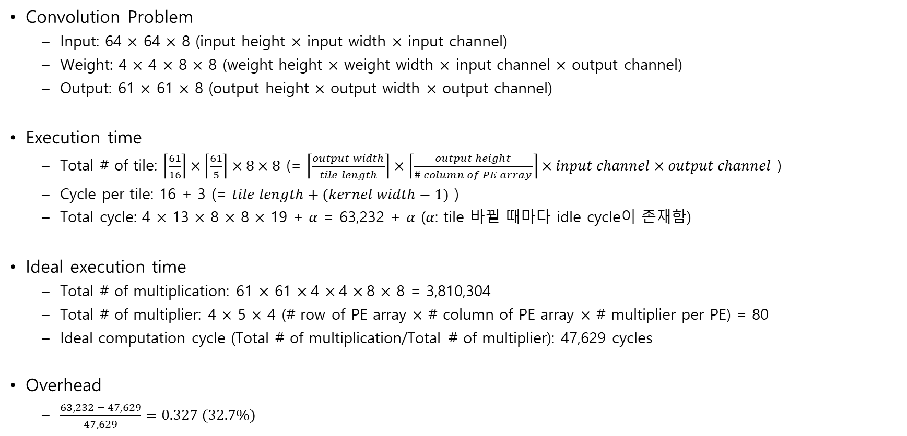
Eyeriss-like CNN Accelerator – Example
Convolution Problem
  Input: 64 $×$ 64 $×$ 8 (input height $×$ input width $×$ input channel)
  Weight: 4 $×$ 4 $×$ 8 $×$ 8 (weight height $×$ weight width $×$ input channel $×$ output channel)
  Output: 61 $×$ 61 $×$ 8 (output height $×$ output width $×$ output channel)
Execution time
  Total # of tile: $\left\lceil \frac{61}{16}\right\rceil ×\left\lceil \frac{61}{5}\right\rceil ×8×8$ (= $\left\lceil \frac{output width}{tile length}\right\rceil ×\left\lceil \frac{output height}{\# column of PE array}\right\rceil ×input channel×output channel$ )
  Cycle per tile: 16 + 3 (= $tile length+(kernel width−1)$ )
  Total cycle: 4 $×$ 13 $×$ 8 $×$ 8 $×$ 19 + $α$ = 63,232 + $α$ ($α$: tile 바뀔 때마다 idle cycle이 존재함)
Ideal execution time
  Total # of multiplication: 61 $×$ 61 $×$4 $×$4 $×$8 $×$ 8 = 3,810,304
  Total # of multiplier: 4 $×$ 5 $×$ 4 (# row of PE array $×$ # column of PE array $×$ # multiplier per PE) = 80
  Ideal computation cycle (Total # of multiplication/Total # of multiplier): 47,629 cycles
Overhead
  $\frac{63,232 − 47,629}{47,629}=0.327 (32.7\%)$
Notes:
Overhead를 줄이려면, Execution time을 줄이는 수 밖에..

Slide 14
PE04
PE04
PE04
PE04
PE04
PE04
PE04
PE04
PE04
PE04
PE04
PE04
PE04
PE04
PE04
PE04
0 | 1 | 2
0 | 1 | 2
0 | 1 | 2
0 | 1 | 2
0 | 1 | 2
0 | 1 | 2
PE04
PE04
PE04
PE04
PE04
PE04
PE04
PE04
PE04
PE04
PE04
PE04
PE04
PE04
PE04
PE04
19 | 20 | 21
PE04
PE04
PE04
PE04
PE04
PE04
PE04
PE04
PE04
PE04
PE04
PE04
PE04
PE04
PE04
PE04
0 | 1 | 2 | 3 | 4 | 5 | 6 | 7 | 8 | 9 | 10 | 11 | 12 | 13 | 14 | 15 | 16 | 17 | 18
19 | 20 | 21 | 22 | 23 | 24 | 25 | 26 | 27 | 28 | 29 | 30 | 31 | 32 | 33 | 34 | 35 | 36 | 37
38 | 39 | 40 | 41 | 42 | 43 | 44 | 45 | 46 | 47 | 48 | 49 | 50 | 51 | 52 | 53 | 54 | 55 | 56
57 | 58 | 59 | 60 | 61 | 62 | 63 | 64 | 65 | 66 | 67 | 68 | 69 | 70 | 71 | 72 | 73 | 74 | 75
76 | 77 | 78 | 79 | 80 | 81 | 82 | 83 | 84 | 85 | 86 | 87 | 88 | 89 | 90 | 91 | 92 | 93 | 94
95 | 96 | 97 | 98 | 99 | 100 | 101 | 102 | 103 | 104 | 105 | 106 | 107 | 108 | 109 | 110 | 111 | 112 | 113
114 | 115 | 116 | 117 | 118 | 119 | 120 | 121 | 122 | 123 | 124 | 125 | 126 | 127 | 128 | 129 | 130 | 131 | 132
133 | 134 | 135 | 136 | 137 | 138 | 139 | 140 | 141 | 142 | 143 | 144 | 145 | 146 | 147 | 148 | 149 | 150 | 151
0 | 1 | 2
3 | 4 | 5
6 | 7 | 8
Notes:
Overhead를 줄이려면, Execution time을 줄이는 수 밖에..

